Slide 1
Improving the Information Gathering Process Workshop Thursday, February 27th, 2020

Slide 2
Improving the Information Gathering Process Workshop
Ontario Community Paramedic Reporting Guidelines / Minimum Data Set (MDS)
Rationale
Themes
Case study exercises
Aggregate Data

Slide 3
Ontario Community Paramedic Reporting Guidelines
Minimum Data Set (MDS)

Slide 4
Ontario Community Paramedicine Reporting Guidelines
Original reporting requirements:
Notes:
3 pages of metrics for each program stream
3 program streams – referral, home visit and clinics

Slide 5
Ontario Community Paramedicine Reporting Guidelines
Current reporting requirements:
Notes:
CPP’ Reporting Tool (Q2,Q4) / MOH Report
Expenditure Report (Variable)
Other reports for different stake holders, pilot programs
Significantly decreased the time to prepare reports, but still ambiguity exists on how to measure indicators
As programs evolved, many key indicators are missing completely

Slide 6
Ontario Community Paramedicine Reporting Guidelines
Minimum Data Set (MDS)
Measure processes, services, and outcomes to understand and evaluate program functioning and impacts
Sections
Data set definitions
Patient encounter Minimum Data Set elements requirements
Reporting submission requirement
Notes:
-The MDS is an opportunity to develop benchmarks for CPP across the province for quality improvement, best practices
-What is the value of CP?

Slide 7
Selection of MDS variables
Many of the variables are required for the MOH report
Report on demographics, interventions, outcomes
Account for changes in Community Paramedic programs over time (CP RPM, treat & release)
More accurately captures activities of Community Paramedic programs (client interactions vs home/clinic visits, referrals vs consultations)

Slide 8
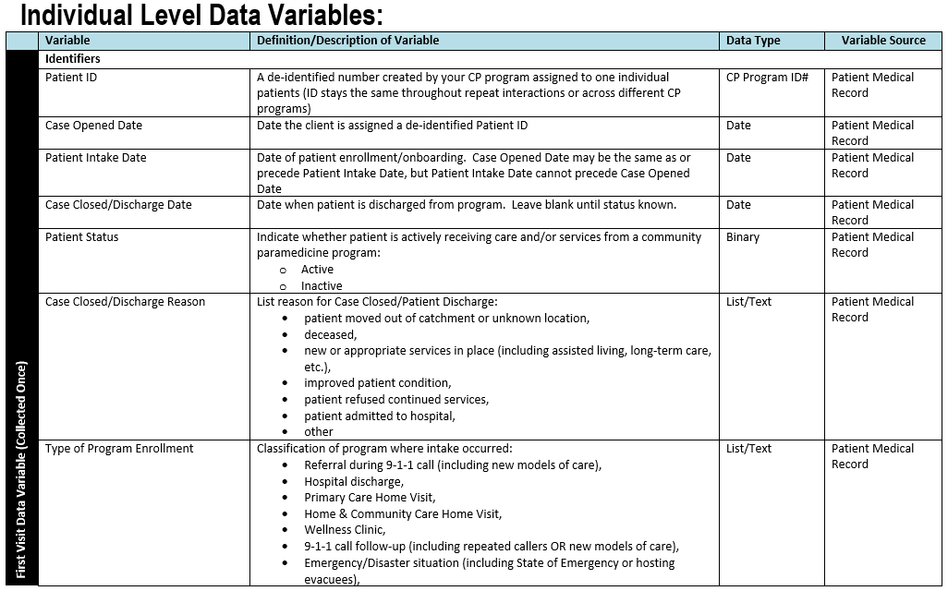
MDS – Individual Data Set Definitions

Slide 9
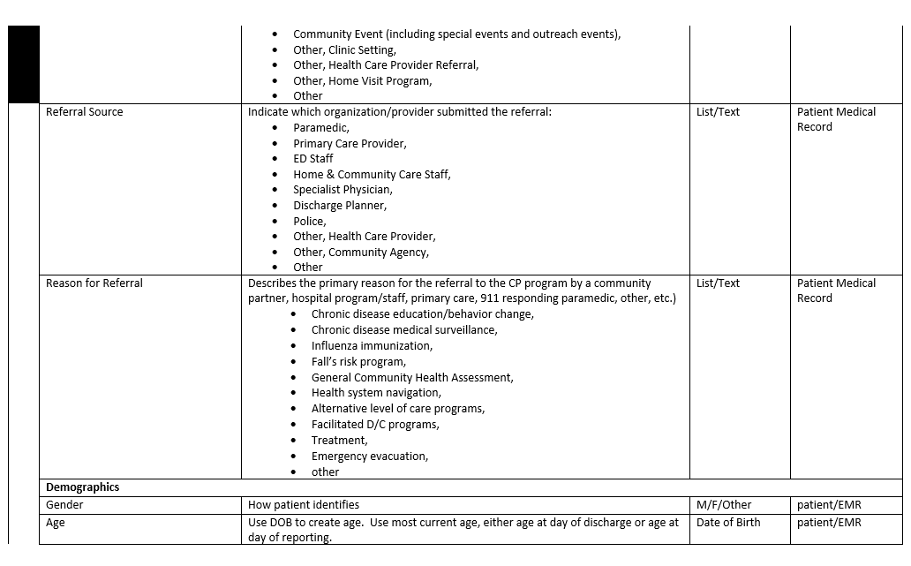
MDS – Individual Data Set Definitions

Slide 10
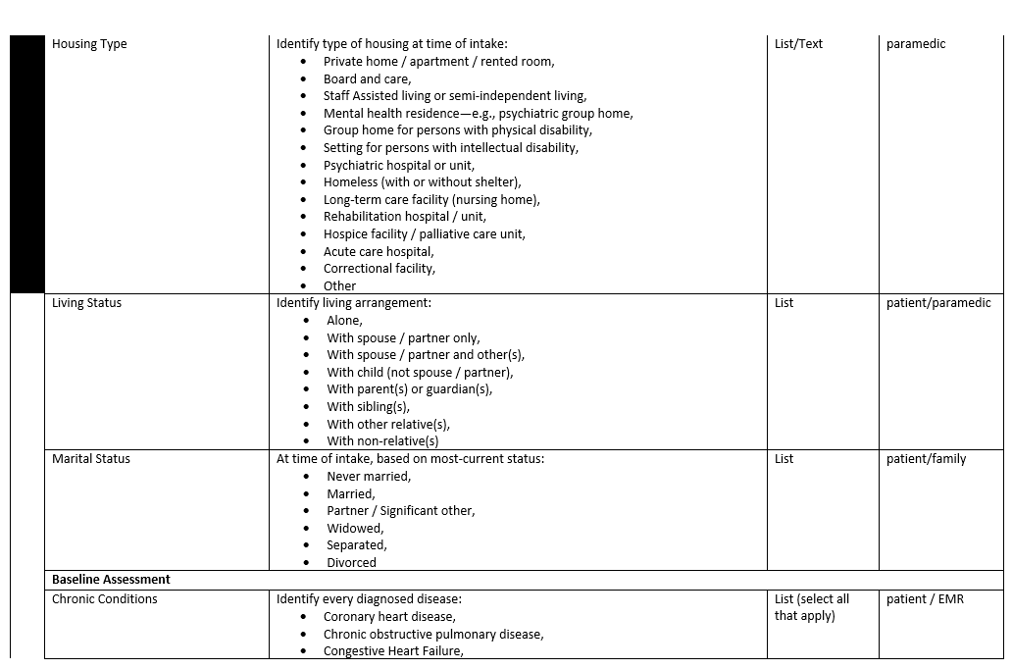
MDS – Individual Data Set Definitions

Slide 11
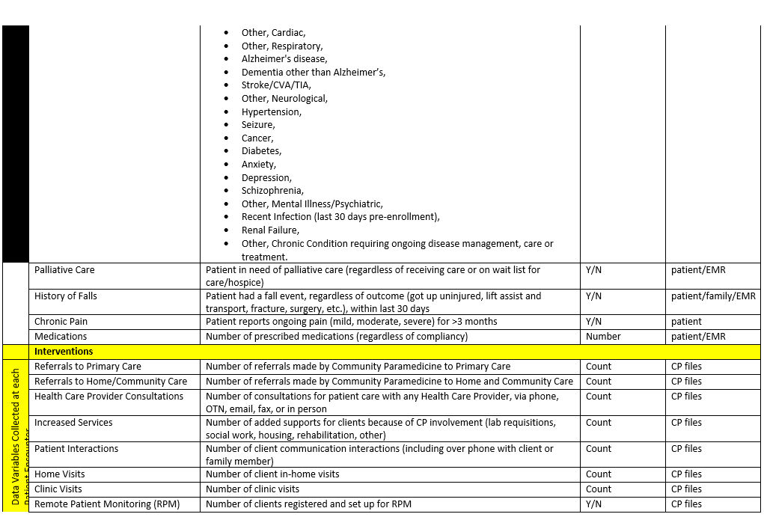
MDS – Individual Data Set Definitions

Slide 12
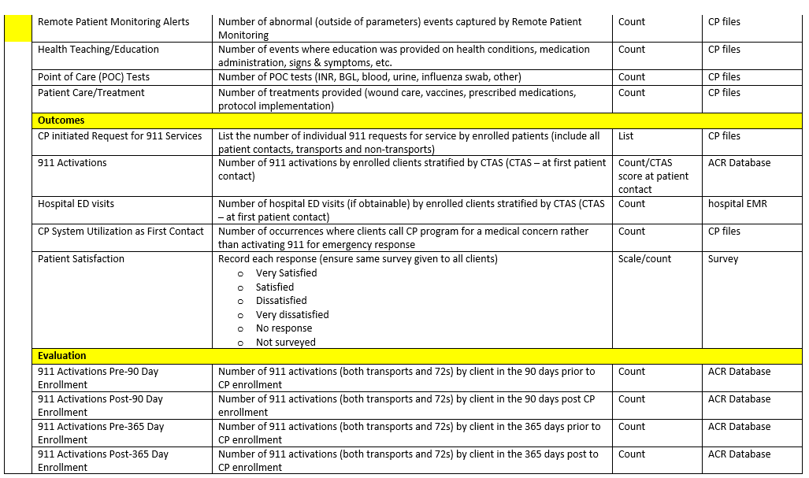
MDS – Individual Data Set Definitions
Notes:
Variable –
Definition / Description of variable
Data Type
Variable source

Slide 13
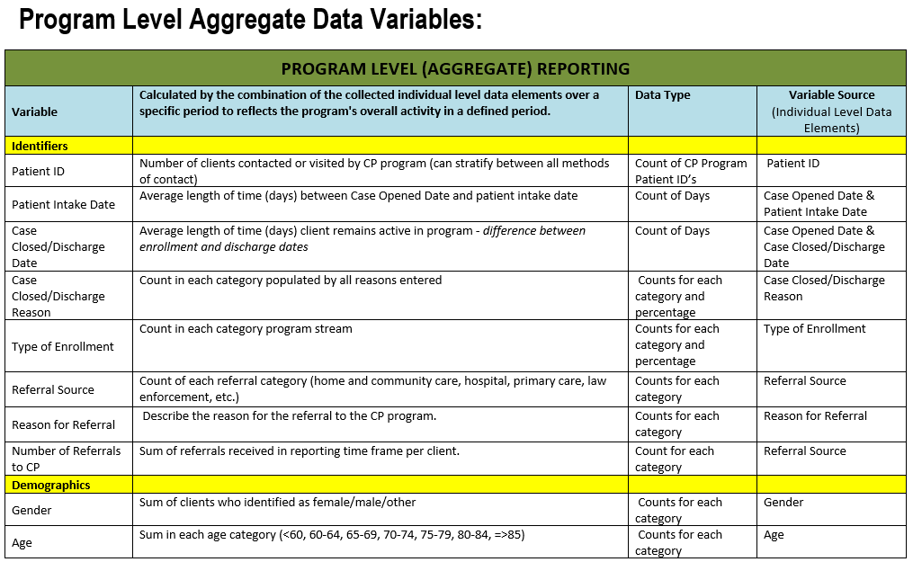
MDS – Aggregate Data Set Definitions

Slide 14
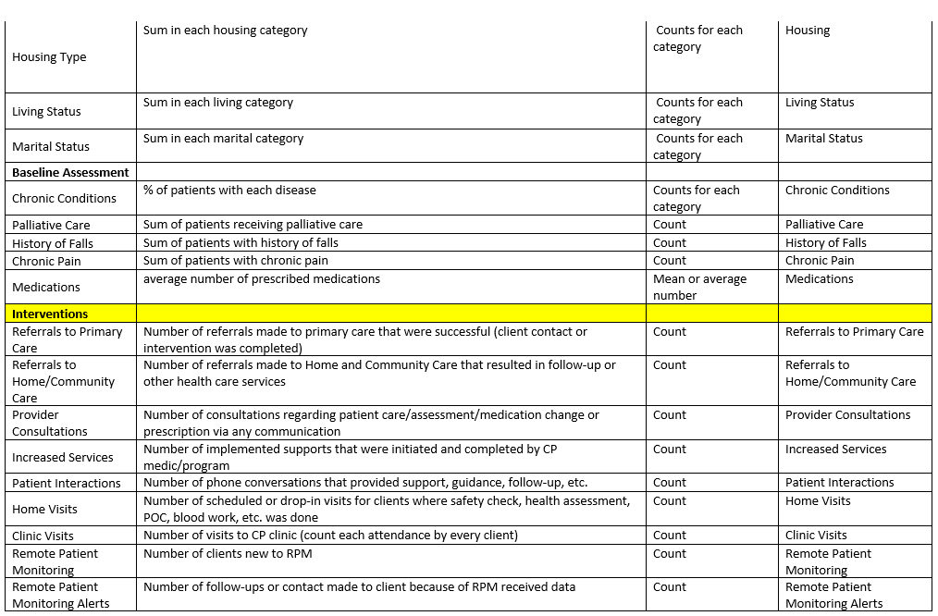
MDS – Aggregate Data Set Definitions

Slide 15
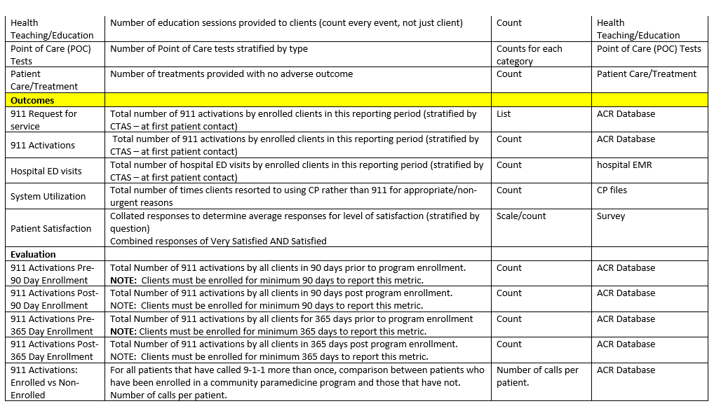
MDS – Aggregate Data Set Definitions

Slide 16
Patient Encounter Requirements for Minimum Data Set (MDS)
An electronic Medical Record (eMR) entry shall be completed for each face to face and telephone patient encounter.
The community paramedic who has contacted, assessed, and/or provided patient care to an individual, shall be responsible for completing the eMR entry.
The eMR entry shall be completed as soon as possible and no later than the end of the scheduled shift or work assignment during which the encounter occurred.

Slide 17
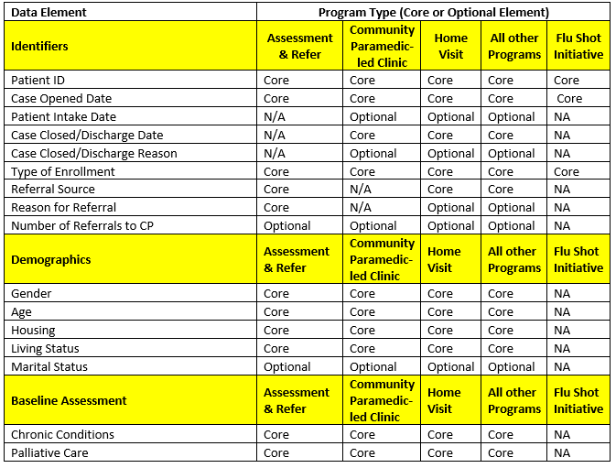
Patient Encounter Requirements for Minimum Data Set (MDS)
The eMR shall be completed according to the Core and Optional requirements in Section 2 of the Guidelines:

Slide 18
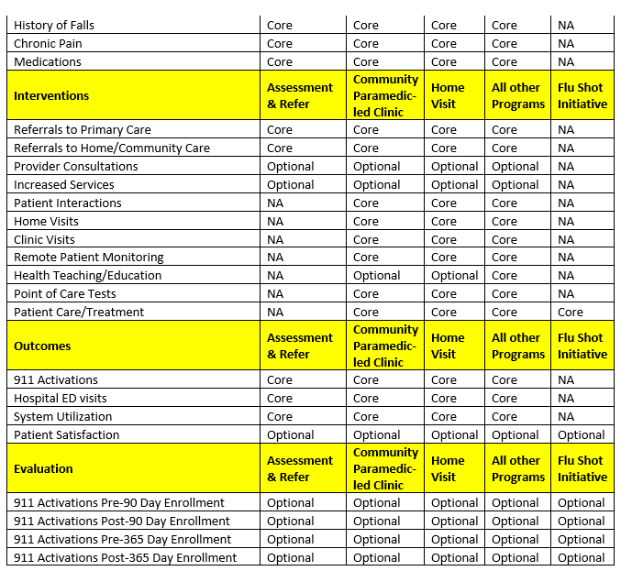
Patient Encounter Requirements for Minimum Data Set (MDS) continued

Slide 19
Reporting Submission Requirement
CP Programs are required to submit their quarterly reports starting Q1 April 1, 2020
It is due to be submitted the first Friday two months after the reporting period
Data from active clients within the reporting period below should only be included in the respective report
Reporting Period | Dates of Reporting Period
Quarter 1 Report | April 1, 2020 – June 30, 2020
Quarter 2 Report | April 1, 2020 – September 30, 2020
Quarter 3 Report | April 1, 2020 – December 31, 2020
Quarter 4 Report | April 1, 2020 – March 31, 2021

Slide 20
Rationale & Themes

Slide 21
Rationale
Develop Benchmarks
Markers of excellence to which organizations can aspire
Help measure or determine the value of Community Paramedicine
Build or improve the foundation for program evaluation
Facilitate Scale & Spread
The lack of mechanisms to support collaboration and learning across jurisdictions hinders the spread of innovative and leading practices
Notes:
Benchmarks should be implement with evidence informed processes

Slide 22
Themes
Although evidence based is critical for benchmarking and scale & spread, emphasis should always be on providing high-quality care
MOH reporting requirements via the LHINs have not changed
Minimum data set – programs can collect any additional variables
Work closely with EMR vendors to streamline this process as much as possible
The Ontario Paramedic Reporting Guidelines is a living document
Notes:
Living document – the variable and definitions can be changed if found to be poorly reported on, inconsistently reported on, or provide poor measure or representation

Slide 23
Case Studies Exercise

Slide 24
Case Studies – Group Activity
Refer to printed materials for each case study
Fill out one Individual Level Data worksheet per patient
Use the MDS guidelines for definitions and requirements
Work together as a group per table and complete all case studies
Each group/table will be assigned to present one case study results and discuss entire group
As a group we will compile the aggregate data report

Slide 25
Aggregate Data
Using Case Studies as Example

Slide 27
Discussion
Questions & Comments

