Slide 1
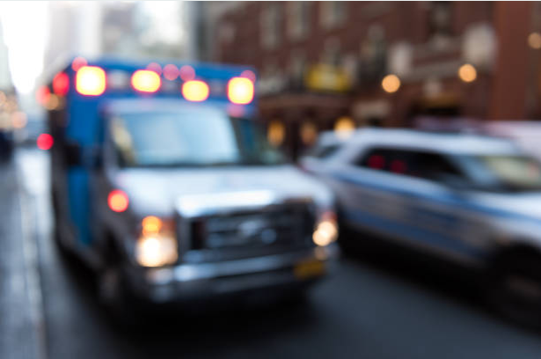
Realizing the potential of integrated care. It takes all of us.
Highlights from the Ontario Community Paramedicine Secretariat Provincial Meeting
October 30, 2019
@JodemeGoldhar
@TheChangeFdn
@NHSHorizons

Slide 2

Overview of the Day
On October 30th, 2019, The Change Foundation was invited to attend the Ontario Community Paramedicine Secretariat monthly meeting. Jodeme Goldhar, Executive Lead, Strategy and Innovation provided the key note address, facilitated a panel discussion and led a workshop all around the theme of integrated care.

Slide 3
KEY NOTE HIGHLIGHTS
Realizing the Potential of Integrated Care.
It Takes All of Us.

Slide 4
Goals of the Keynote
Learn about what integrated care is and how its been implemented successfully around the world
Learn about what the seismic shifts are, how they will help to unleash the potential for integrated care, and example of the shifts that have occurred in the NHS paramedic services
Celebrate the many successes in community paramedicine in Ontario

Slide 5
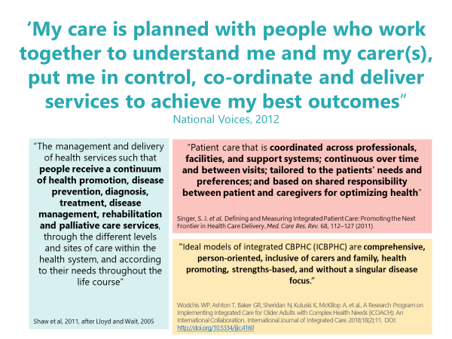
Definitions of Integrated Care

Slide 6
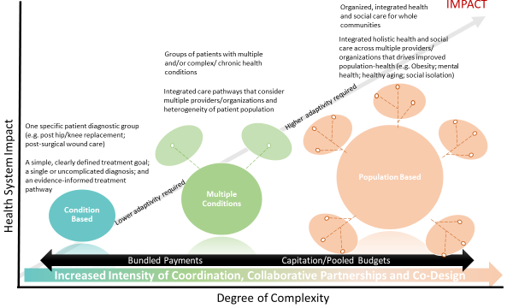
Overview of Integrated Health Systems
Note the increased intensity to coordinate, collaborate and co-design population-based care as well as the potential for greater health system impact.
Notes:
An overview of integrated health systems was provided, outlining the increased intensity to coordinate, collaborate and co-design population-based care as well as the potential for greater health system impact.

Slide 7
Integrated Health Systems Around the World
England, United Kingdom
A focus on population health- moving to Integrated Care Systems everywhere by April 2021; ‘Triple integration’ of primary care and specialist care, physical and mental health services, and health with social care.
https://www.england.nhs.uk/integratedcare/integrated-care-systems/
Scotland, United Kingdom
9 health and well-being goals; House of Care framework builds a shared understanding of the critical success factors required to turn the rhetoric of health and social care, and primary care policies, into every day implementation.
https://www.alliance-scotland.org.uk/health-and-social-care-integration/house-of-care/
Canterbury, New Zealand
Changing cultures and strengthening competencies…to an integrated system, where people and systems talk to each other.
https://www.kingsfund.org.uk/sites/default/files/field/field_publication_file/quest-integrated-care-new-zealand-timmins-ham-sept13.pdf
Alaska, U.S.A.
Nuka System of Care: A Relationship-based, customer-owned approach to transforming health care, improving outcomes and reducing costs.
https://www.southcentralfoundation.com/nuka-system-of-care/

Slide 8
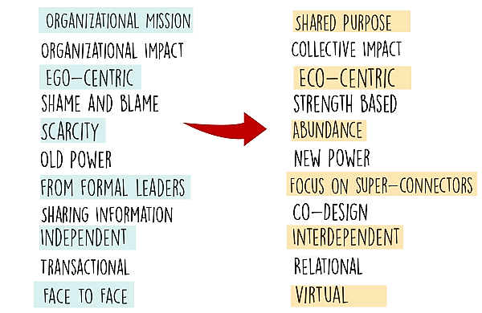
The Seismic Shifts
Moving from the left to the right will help realize the potential for integrated care by enabling organizations to think, work and act differently.

Slide 9
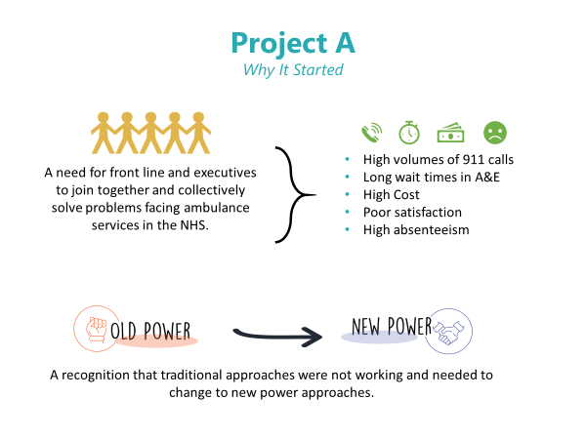
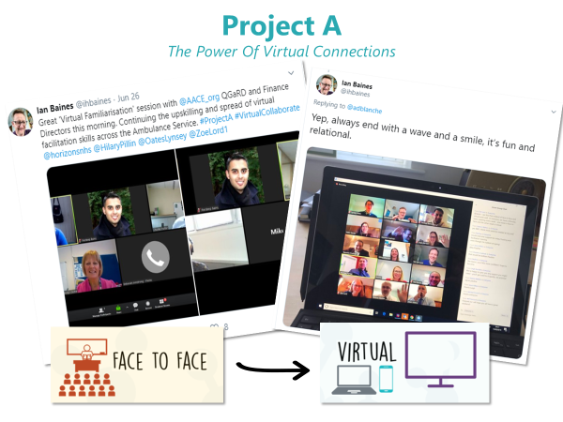
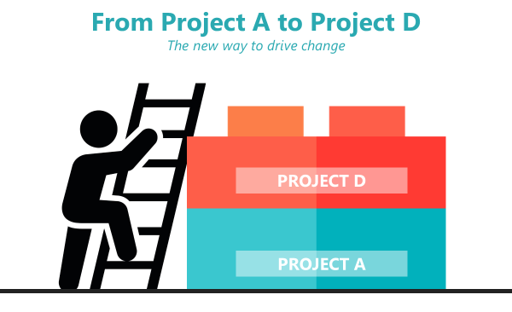
Project A and Project D
Examples of how we can do things in new power ways to bring about change in ambulance services in the UK. For more information: https://aace.org.uk/national-programme/project-a/

Slide 10
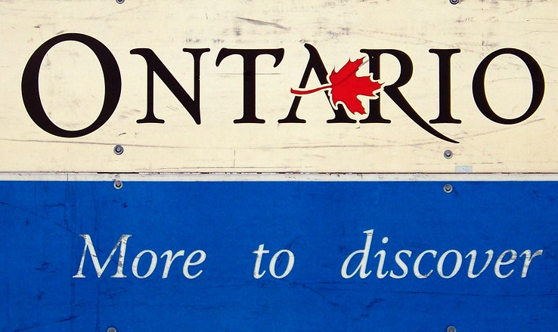
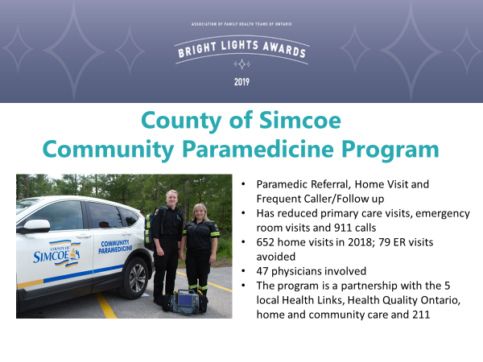

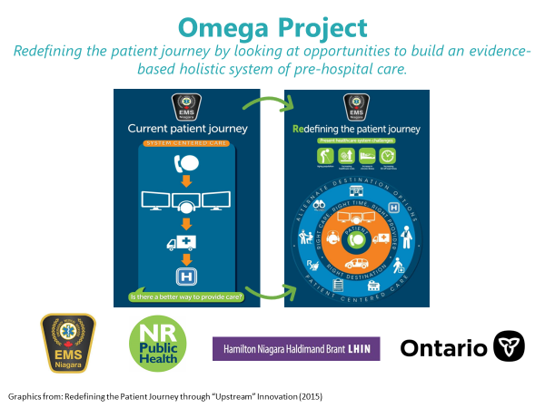
A celebration of some of the great work already happening in community paramedicine
A

Slide 11
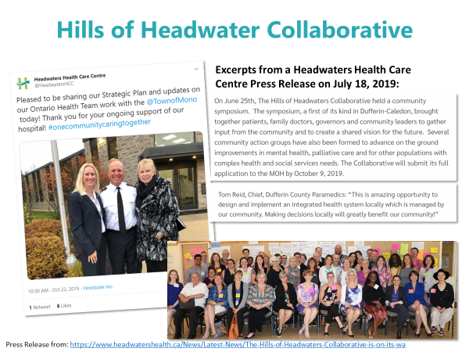
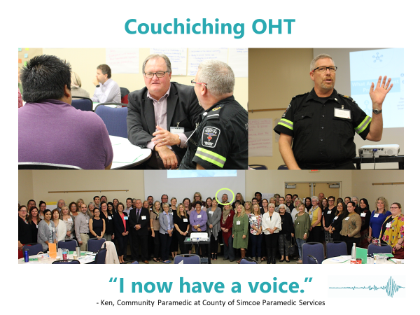
Supporting Communities
Community Paramedicine has an integral role in supporting communities to realize the potential for integrated care.
Tom Reid, Chief, Dufferin County Paramedics: “This is an amazing opportunity to design and implement and integrated health system locally which is managed by our community. Making decisions locally will greatly benefit our community!”
Ken, Community Paramedic, County of Simcoe Paramedic Services: I now have a voice.” [When asked what the seismic shifts mean to him when he attended a planning symposium for the Couchiching OHT]

Slide 12

Reflections
Participants were encouraged to reflect on some questions
How do we take this good work and accelerate it, amplify it, make it the new normal for Ontarians?
How will Community paramedicine build on its strengths and realize these seismic shifts in the everyday?

Slide 13
PANEL DISCUSSION HIGHLIGHTS
Community Paramedicine in OHT Applications

Slide 14
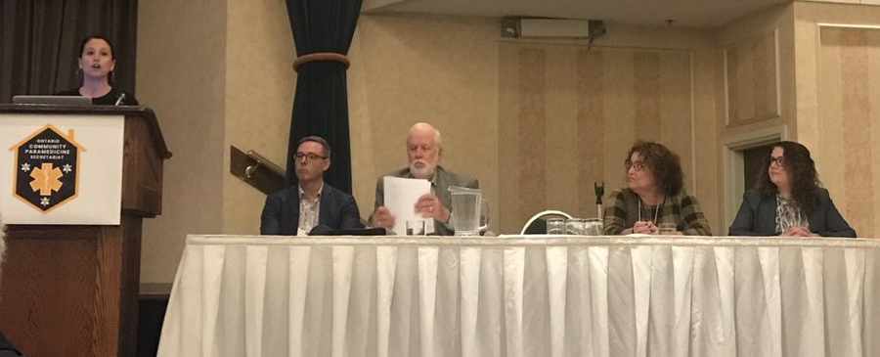
In the afternoon, Jodeme facilitated a panel discussion with:
John Flemming #Hamilton OHT
Meredith Morrison @simcoecountyPS
Dave Pearson @CentralWestLHIN
Dr. Roshan Shafai @MSHospital

Slide 15
Goals of the Panel Discussion
Hearing from a panel of experts on their perspectives on integration and work in Ontario Health Teams
Hear questions and perspectives from participants

Slide 16

Panel Discussion
Opportunities with the OHTs
Recognizing that the solution is in the integration and participation with various partners
Understanding the resources we have and build the best system we can
The transformational opportunity in health and social care.
Working towards a shared purpose and vision – breaking down silos and coming together across health and social care to jointly identify priorities and working together to solve issues
Common approach through CP governance bodies would help CPs connect with other HCPs
Involving CPs as a core member of the healthcare team
Notes:
-Are there any plans to evolve the way coordinated care plans are automated/digitalized so that they can become more dynamic and in real-time where the patients and their family care givers can also contribute to their CCP in real time via a patient portal?
-As a group, what do you see as the educational needs or gaps of community paramedics in your communities?
-is there anyway to investigate on how we can re-coupe some of the costs our CP programs are saving the province?
-EMS services are evaluated by respond times. is ministry will change the way to evaluate EMS service as we know only less then 20% of calls that rapidity to respond manner.

Slide 17
Panel Discussion
Strategies for Collectively Moving Forward
“As a collective, our impact can be astronomical.”
Talk openly about barriers
Be out front and leading the change, while recognizing that tensions do and will exist
Identify what is / is not within our control to lead or change (i.e. changing legislation like the Ambulance Act)
Co-design the answers with patients and families
“Community paramedicine is the glue. “
Notes:
-Are there any

Slide 18
WORKSHOP HIGHLIGHTS
Exploring the landscape and identifying our opportunities.

Slide 19
Goals of the Workshop
Discuss the role of community paramedicine
Continue building on strengths and opportunities for the future

Slide 20




Strengths of Community Paramedicine
These are some of the key strengths of community paramedicine that were identified during the workshop.
Assessment
Communication
Flexibility
knowledge & skills

Slide 21
Opportunities
These are some of the key opportunities for the role of community paramedicine that were identified during the workshop.
Consistent measurement of outcomes
Education about the role of paramedics
Enhancing digital health (EMR access, virtual care)
Role definition
Focus on targeted populations (i.e. palliative, mental health, etc.)
Continued innovation
Continuing to strengthen communication
Sharing/ spread of ideas
Prevention and community care

Slide 22





Principles for Working Together
These are some of the principles that participants identified for working together and across the system to achieve integration.
Flexibility: Continue to adapt, change and be nimble and responsiveness to the needs in our community
Communication & Collaboration: Work closely with each other, and with our partners; listen openly and ensure we have a unified voice
Integration: Build and accelerate on our work together and in partnership with others (i.e. OHTs)
Understand and support: Seek to understand and support each other in our roles; get to know people and what each person can bring to the table
Listen to patients / caregivers: Listen to patients/ caregivers/ family stories, in their setting, in their world to understand their perspectives.

Slide 23
MOVING FORWARD
Next Steps

Slide 24

What’s Next?
Continue to support Community Paramedics and help maximize collective efforts in order to build system-wide improvements
Work with health and social system partners to help advance the integrated approach to care being built through the OHTs and maximize collective efforts of community paramedicine.
  The handout “Community Paramedicine: Part of the Team” prepared by the OCPS is a useful guide for continuing the conversations with Ontario Health Teams.

Slide 25

Thank you!
@JodemeGoldhar
@TheChangeFdn
@IFICInfo
@horizonsNHS

