Slide 1

Partnership between Paramedics and Public Health for COVID-19

Slide 2
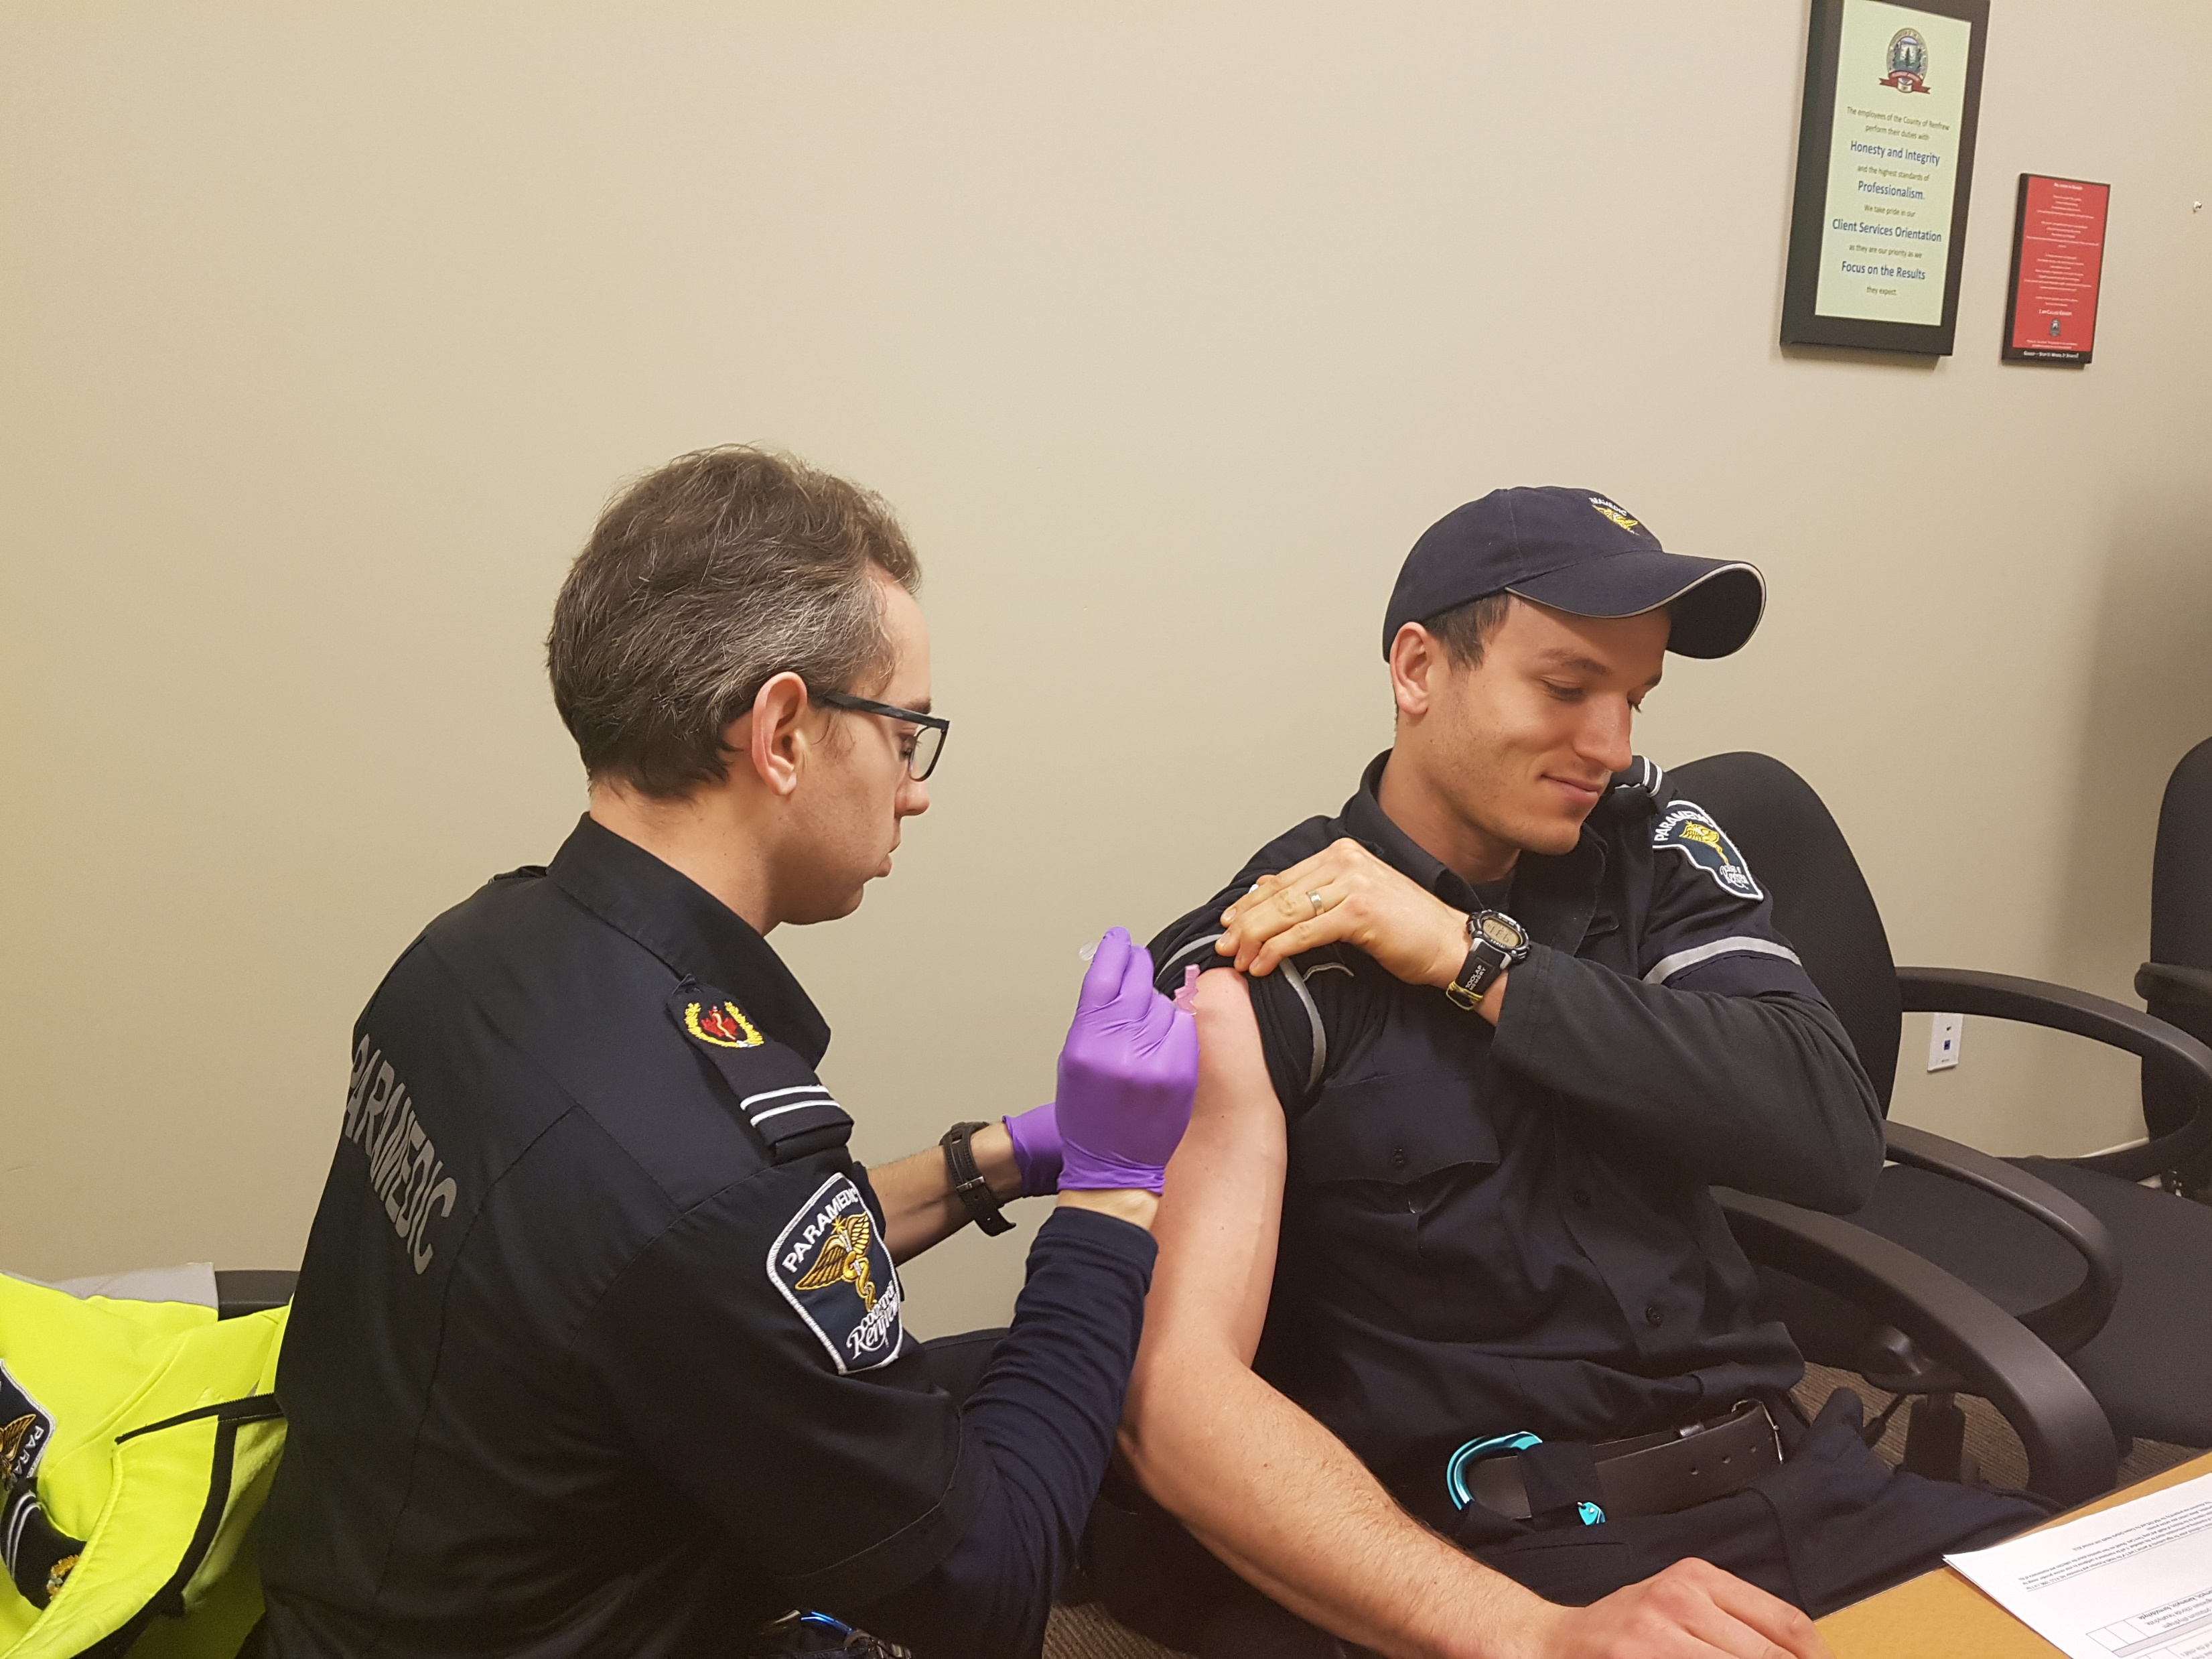
Influenza 2017-18
LHIN funded program to help with the seasonal influenza surge.
Additional training on assessment, identification, testing and treatment of the influenza virus.
2 additional CPRU paramedics on staffed 12 hours day, 7 days/week.
200 vaccines administered at 15 clinics throughout the county.
24hr access to a paramedic via 1-844 #.

Slide 3
Influenza 2017-18
>100 ED diversions...and counting.
5% decrease in 911 calls for same time period where CP programs exist.
85% of patients are >75 years of age
18% increase in code 72 during the same time period.
945 Home visits completed.

Slide 4
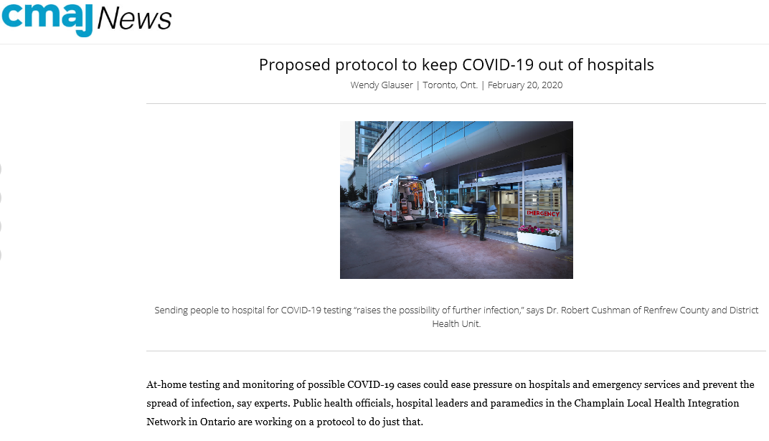
Home assessment for COVID-19 would “save precious resources.” Paramedics wouldn’t need to transport patients to hospital unnecessarily and then need to do all the decontamination and disinfection of equipment and the ambulance.

Slide 5
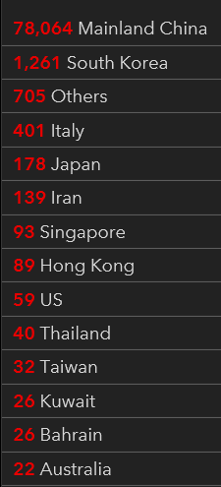
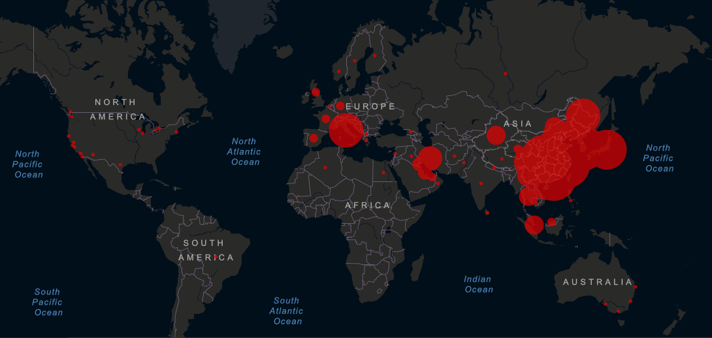
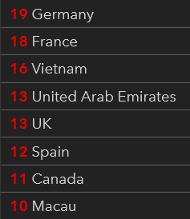
https://gisanddata.maps.arcgis.com/apps/opsdashboard/index.html#/bda7594740fd40299423467b48e9ecf6
Dispatch expanded their screening to the case definition to include China, Hong Kong, Iran, Italy, Japan, Singapore and South Korea.

Slide 6
Our Goal s
Right Care
Right Patient
Right Time
Right Place
The First Time

Slide 7
Objectives
Decrease Hallway Health Care
Decrease off load delay
Decrease disruption to emergency response capacity
Increase community based testing by Paramedics
Reducing the risk of transmission during unnecessary travels to hospital
Reducing the risk of transmission to the general population
Relieve the burden of transporting suspect cases by Paramedic Services to and from hospital
Increase public confidence in self-care
Reduce 911 utilization
Improve Public Health / Paramedic Service inter-professional collaboration

Slide 8
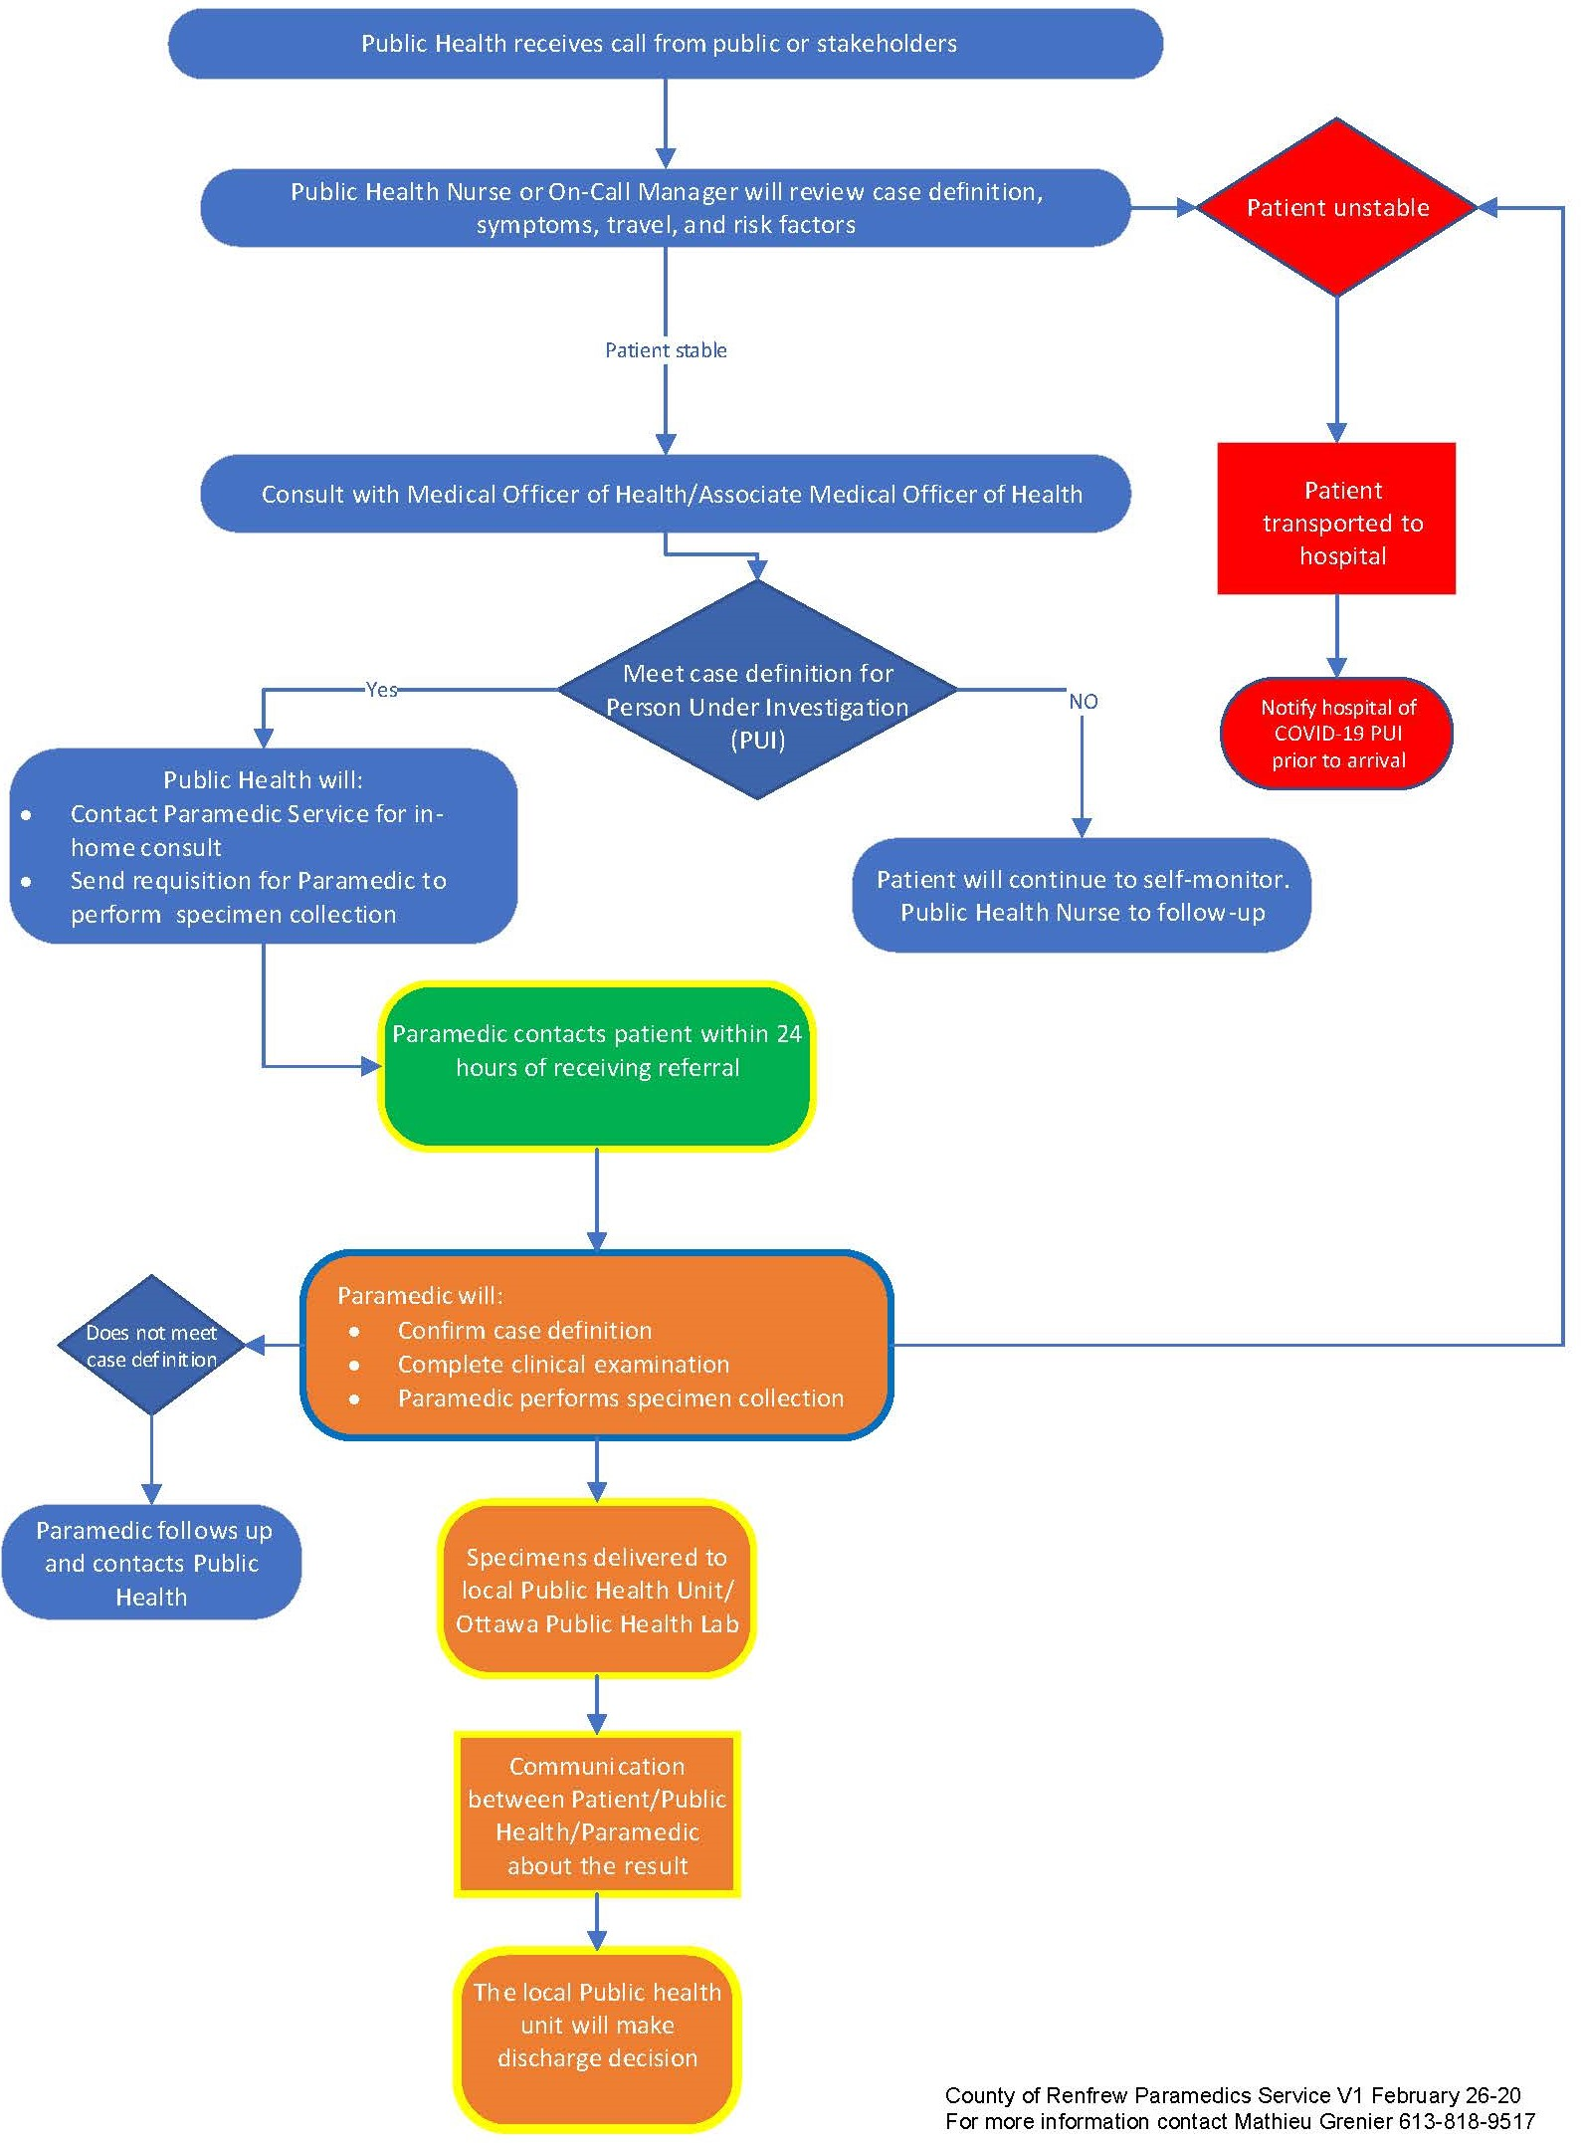

Slide 9
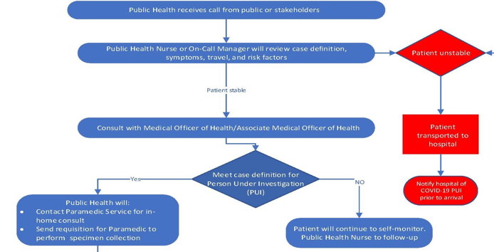

Slide 10
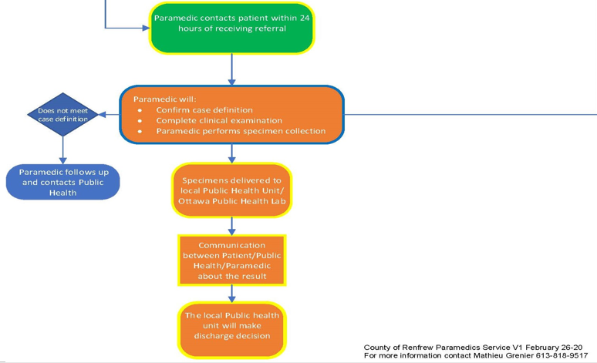

Slide 11
Specimen Collection
Upper respiratory tract:
Nasopharyngeal (NP) swab
Viral throat swab
3) Sputum: collect if patient has a productive cough

Slide 12
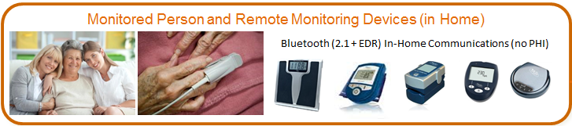
Patients use the provided equipment to obtain regular vital signs
Vital sign readings are transmitted to secure software portal
Software automatically alerts Community Paramedics of abnormal vital sign readings
Community Paramedics follow up on each alert to determine the care needed
Thermometer
iPad with OTN / facetime capability
Community Paramedic Remote Patient Monitoring (CPRPM)

Slide 13
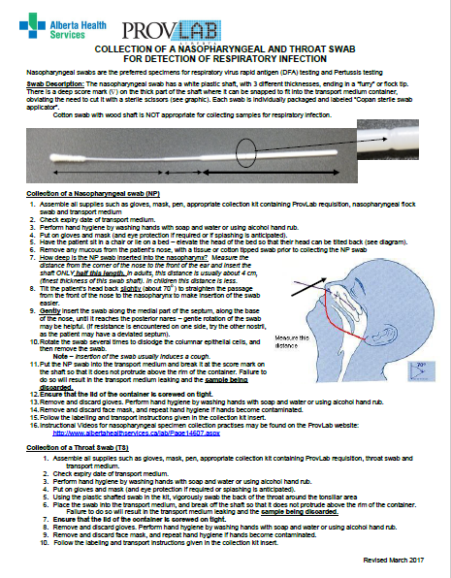
Alberta Health expands testing
protocols as COVID-19 continues

Slide 14
England’s National Health Service began piloting a home-testing program for COVID-19 in London, UK.
The pilot launched after 25 of the city’s ambulances were decommissioned for decontamination in a single afternoon after transporting suspected cases.
As of mid-February, the program has tested more than 130 patients.

Slide 15
Questions?
For a copy of the Influenza and COVID19 clinical practice guidelines, please contact:
Mathieu Grenier
mgrenier@countyofrenfrew.on.ca
613-818-9517

